Slide 1
et simulation project
30th Sep 2020

Slide 2
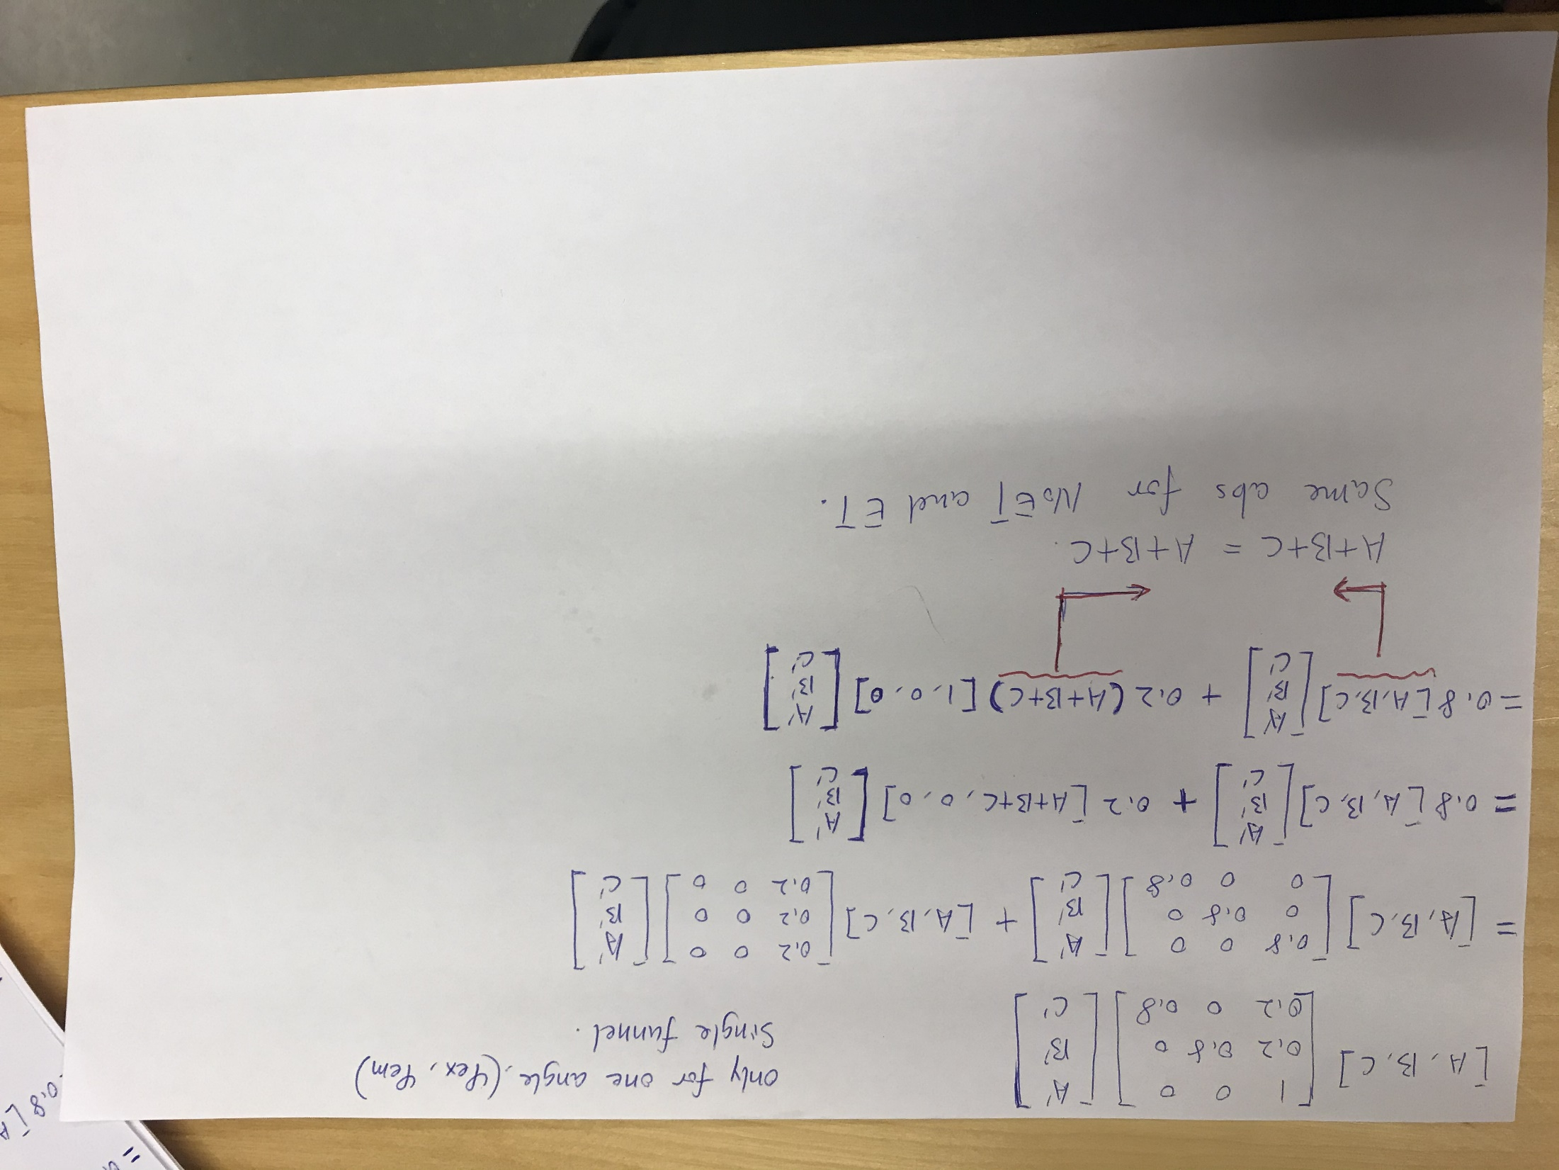

Slide 3
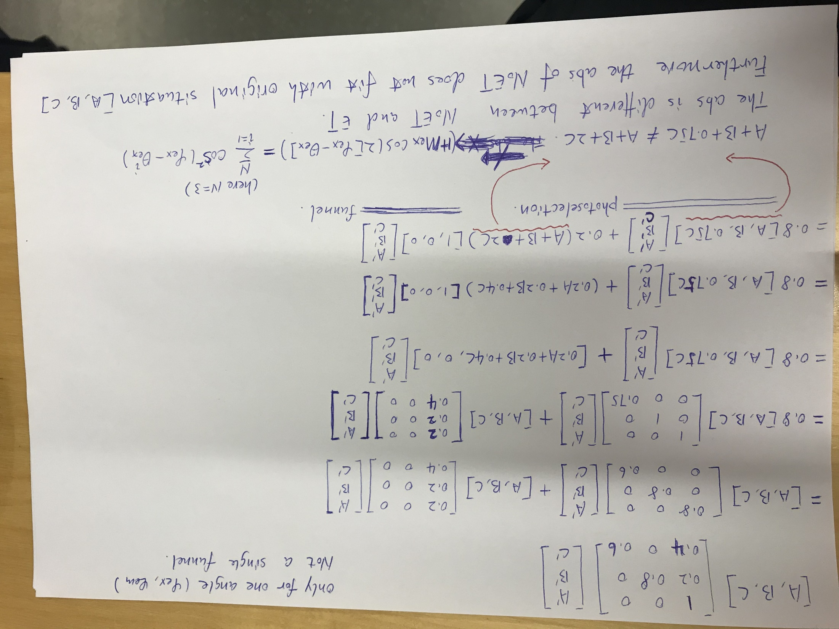

Slide 5
Section 1: Multiple emitters (extension of SFA3 model)

Slide 6
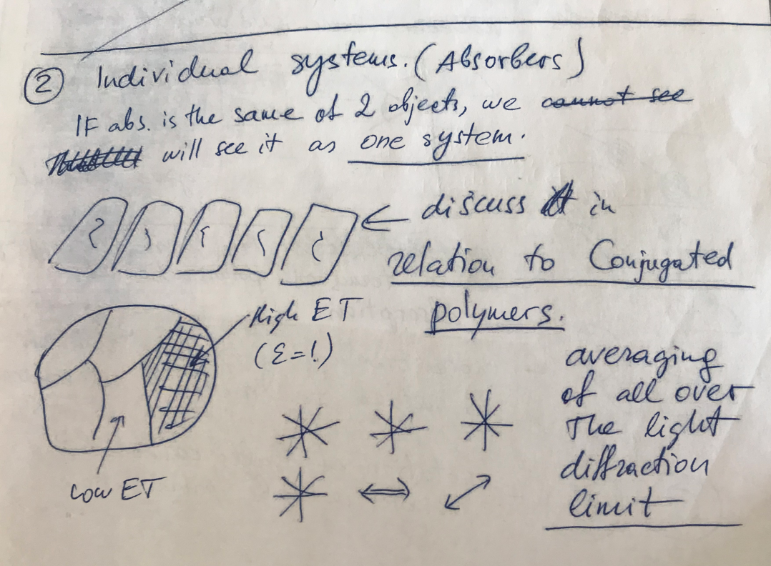
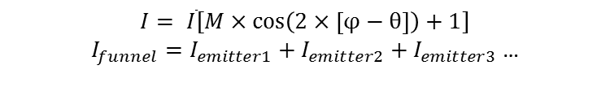
Multiple systems (ms) possessing their own emitter and 𝜀
-- Conjugated polymer (bulk material)
0.8
0.2
0.2
0°
36°
72°
P1
P2
P3
et_1 = 0
et_2 = 0.2
et_3 = 1
Pms = P1 + P2 + P3
SFA3 fitting results
 | P1 | P2 | P3 | Pms
M_funnel | 0.00 | 0.98 | 0.88 | 0.77
phase_funnel (degree) | - | 0 | 42 | 36
𝜀 | 0.00 | 0.20 | 1.00 | 0.40
SFA3 works well for all the above systems.
The funnel is linealy combination of individual system.
𝜀_ms = (𝜀1 + 𝜀2 + 𝜀3)/3.
$$I= \overline{I}[M×\cos\left(2×\left[φ−θ\right]\right)+1]$$
$I_{funnel}=I_{emitter1}+I_{emitter2}+I_{emitter3}$ …

Slide 7
Mf_i is always equal to 1

Slide 8
Multiple systems (ms) possessing their own absorption, but the same et and emitter.
The numbers of the absorbers are the same for all systems. The absorbers are oriented in P1 (0 – 180 degree), P2 (0 – 60 degree), P3 (20 – 40 degree).
The residue is slightly higher, but SFA model still can works.
𝜀1 = 𝜀2 = 𝜀3 = 1 then 𝜀_ms = 1 as well.
(More test: 𝜀1 = 𝜀2 = 𝜀3 = 0.2 then 𝜀_ms = 0.2 as well.)
The sum of the sub-systems still correspont to he defination of SFA3 model. Chromophores have the same amout of et to the same emitter.
The property of funnel is independent on the anisotropy of sample (dipole orientation).
1.0
1.0
1.0
36°
36°
36°
P1
P2
P3
et_1 = 1.0
et_2 = 1.0
et_3 = 1.0
Pms = P1 + P2 + P3
SFA3 fitting results
 | P1 | P2 | P3 | Pms
M_funnel | 0.99 | 0.99 | 0.99 | 0.99
phase_funnel (degree) | 36.00 | 36.00 | 36.00 | 36.00
𝜀 | 1.00 | 1.00 | 1.00 | 0.99
residue | 0.00 | 0.00 | 0.00 | 0.001
As long as the absorption can be fit by three dipole model, SFA3 should still work.

Slide 9
The numbers of the absorbers are the same for all systems. The absorbers are oriented in P1 (0 – 180 degree), P2 (0 – 60 degree), P3 (20 – 40 degree).
The model does not break, however, after sum up the three systems, the funnel property (phase and et) is changed with the absorption and et in each sub-system. This does not fit in the reality.
Why does the model fail to explain the reality?
It is because that the sum of three systems does not correspond to the defination of SFA anymore. Chrmophores have different et to the emitter.
0.2
0.5
0.6
36°
36°
36°
P1
P2
P3
et_1 = 0.2
et_2 = 0.5
et_3 = 0.6
Pms = P1 + P2 + P3
SFA3 fitting results
 | P1 | P2 | P3 | Pms | Pms (fix phase at 36)
M_funnel | 0.997 | 0.999 | 0.999 | 0.999 | 0.999
phase_funnel (degree) | 36.241 | 35.975 | 35.971 | 40.310 | 36
𝜀 | 0.200 | 0.500 | 0.6022 | 0.264 | 0.288
residue | 0.0003 | 0.0001 | 0.0000 | 0.0016 | 0.0062
Mex_i is not always equal to 1

Slide 10
We have the conclusion for multiple systems, as long as one of the term is the same for all the systems, then the model will work.
Then if we have one system possessing many emitters, how to split it into multiple systems so that we can use the above criteria.

Slide 11
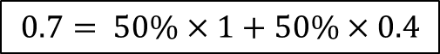
$$0.7= 50\%×1+50\%×0.4$$
system1
system2
50%
50%
+
=
0.1
0.3
0.2
0.6
0°
36°
0°
36°
The abs polarization can not be considered in the et matrix.
The abs strength is considered in the et matrix.

Slide 12
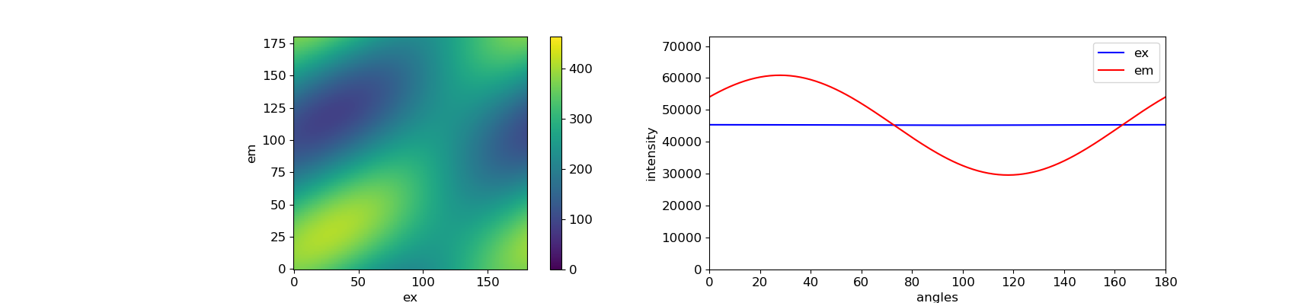
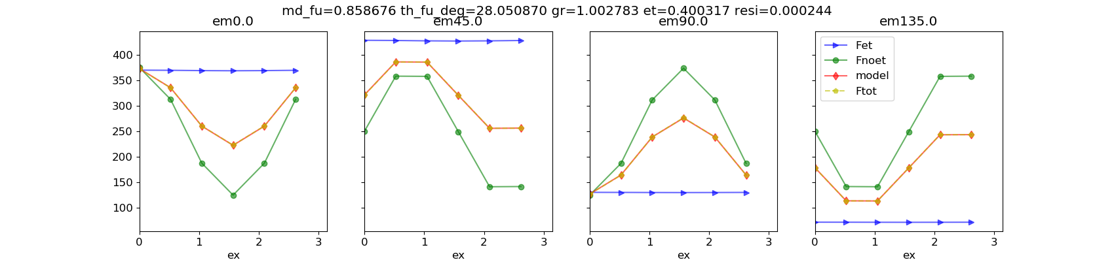
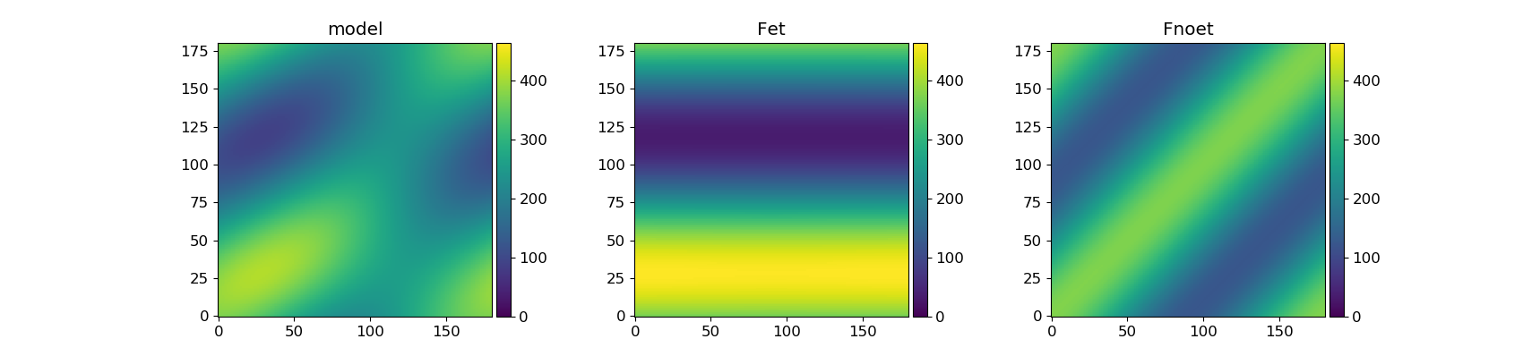
0.2
0.6
0°
36°
P1
P2

Slide 13
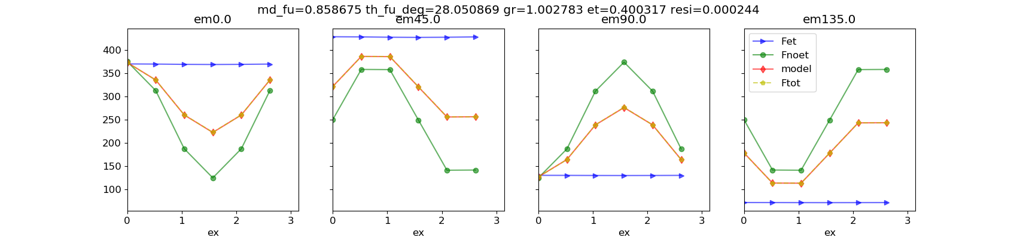

0.1
0.3
0°
36°

Slide 14
2. Four dipoles homogeneously distributed [0, 30, 60, 90]. Energy transfer to two emitters.
(blue - excitation, red - emission)
Case 1
Case 2
Case 3
0.8
No et
0.2
[0.2, 0.8, 0.0, 0.0]
[0.2, 0.8, 0.0, 0.0]
[0.2, 0.8, 0.0, 0.0]
[0.2, 0.8, 0.0, 0.0]
[1.0, 0.0, 0.0, 0.0]
[0.0, 1.0, 0.0, 0.0]
[0.2, 0.8, 0.0, 0.0]
[0.2, 0.8, 0.0, 0.0]
[1.0, 0.0, 0.0, 0.0]
[0.0, 1.0, 0.0, 0.0]
[0.2, 0.8, 0.0, 0.0]
[0.2, 0.8, 0.0, 0.0]
Emitters are also being excited, and they exchange energy with each other.
Model works ideally.
M = 0.917
Phase = 25 degree
gr= 1.02
et = 1
residue = 0.000
The funnel is linear superposition of emitters. If the angle between emitters becomes larger, for example, two emitters at 0° and 100°, then the M_funnel will be decreased to 0.62.
Emitters are also being excited, but they do not exchange energy with each other.
Model does not work ideally.
M = 0.99
Phase = 18 degree
gr= 2.64
et = 0.815
residue = 0.016
The funnel (red curve) is not perfectly linear superposition of emitters (yellow dashed curve). Even the angle between emitters becomes larger, for example, two emitters at 0° and 100°, the M_funnel is still equal to 1.
Emitters are not excited, they only emit light.
Model works ideally.
M = 0.917
Phase = 25 degree
gr= 1.03
et = 1.0
residue = 0.000
These matrix are wrong. They can not be split into perfect SFA sub-systems.

Slide 15
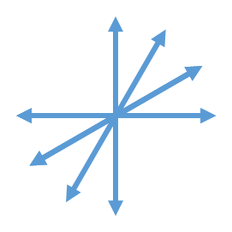
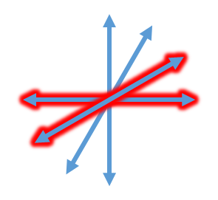
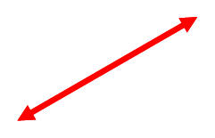

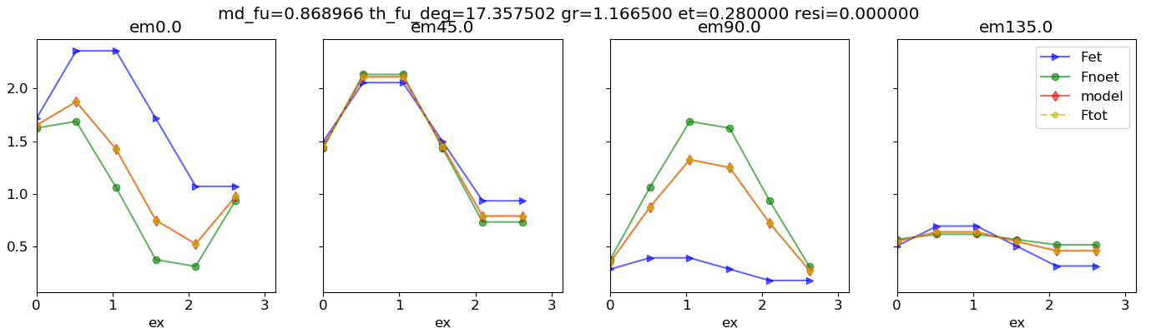
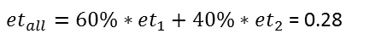
$et_{all}=60\%∗et_{1}+40\%∗et_{2}$ = 0.28
It does not matter if the emitters are excited or not.
Key point is that the matrix needs to be written in a right way so that the single system can be split into SFA sub-systems.
+
=
0.2
0.4

Slide 16
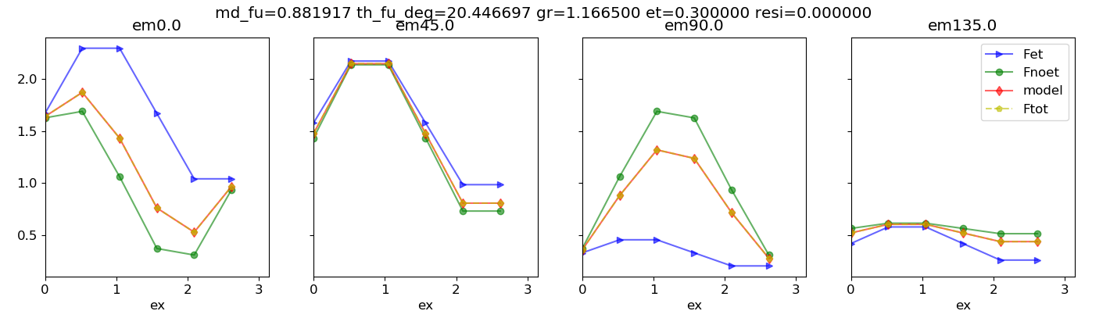
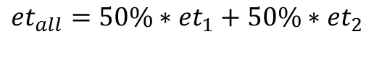
et = 0.3
$$et_{all}=50\%∗et_{1}+50\%∗et_{2}$$

Slide 17
Section 2: Three-dipole model

Slide 18
1. Four dipoles, No ET
The fitting results are dependent on the orientation (distribution) of the dipoles. The model works ideally when the dipoles are homogeneously distributed, such as [0, 30, 60, 90], but it does not work well when dipoles oriented inhomogeneously, such as [0, 60, 70, 90]. (More distributions have been tested). Maybe this is becasues that the three dipole model is symmetric.
For the inhomogeneously distributed dipoles ([0, 60, 70, 90]), the model works better when the energy transfer efficiency is higher. Because of the funnel, the system loses the excitaiton information (excitation anisotropy).

Slide 19
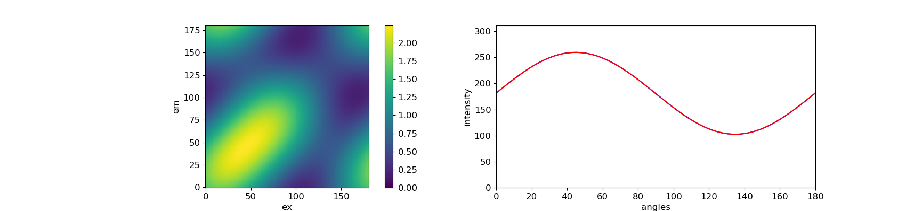
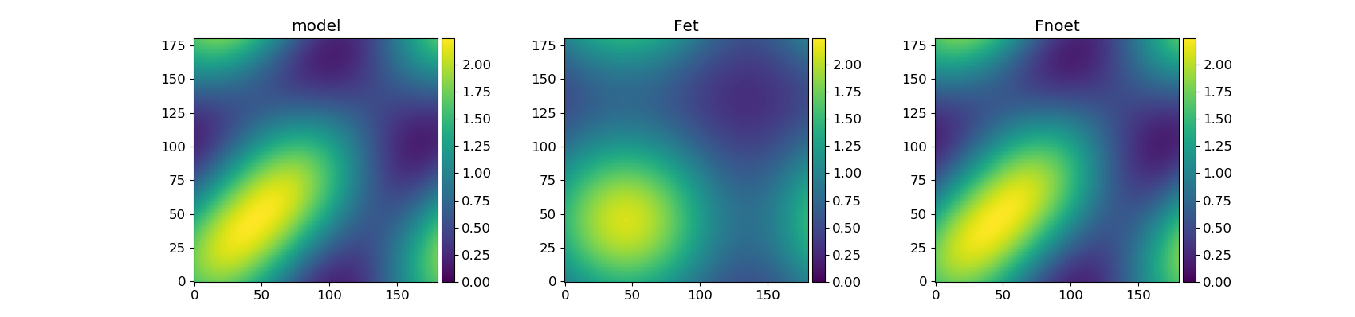
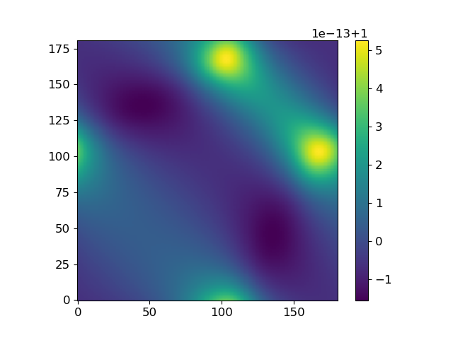
[0, 30, 60, 90], no et, the fitting is ideal
raw portrait
The model works ideally when the dipoles are homogeneously distributed [0, 30, 60, 90].
The difference between the original portrait and model (raw portrait/model) is very small as shown in the left figure.
Raw portrait / model

Slide 20
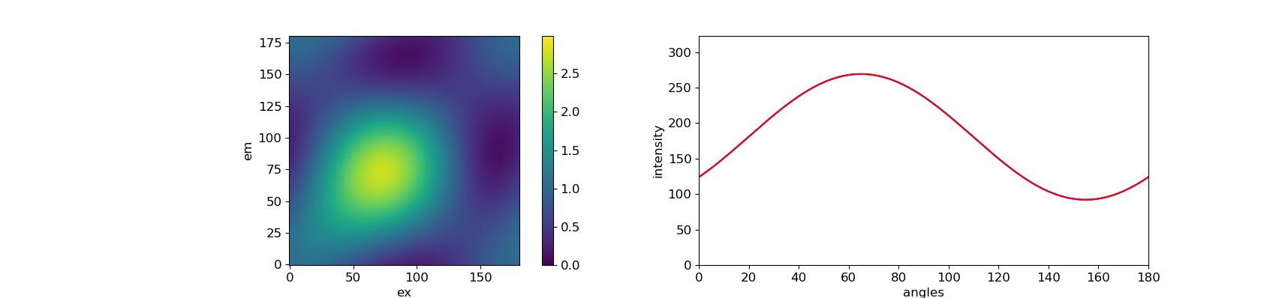
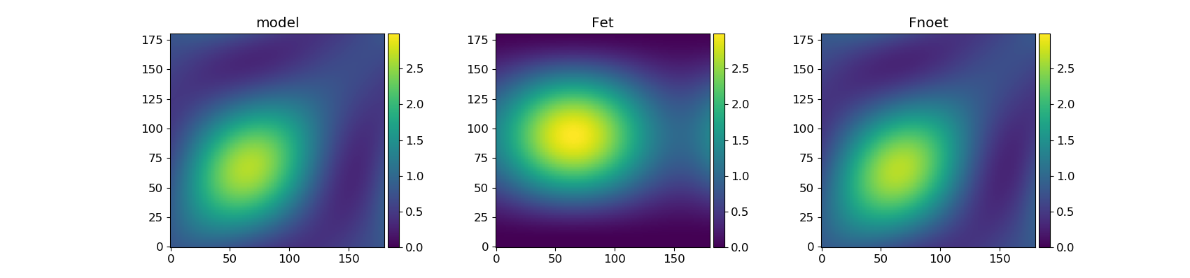
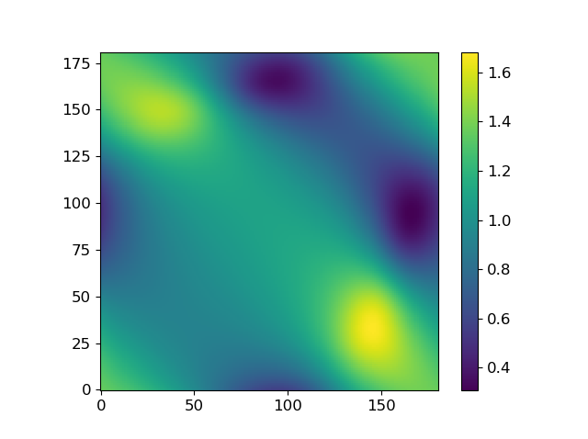
[0, 60, 70, 90], no et, the fitting is not ideal.
raw portrait
The model does not work ideally when the dipoles are inhomogeneously distributed [0, 60, 70, 90].
The difference between the original portrait and model (raw portrait/model) is much larger in comparison with the [0, 30, 60, 90].
Raw portrait / model

Slide 21
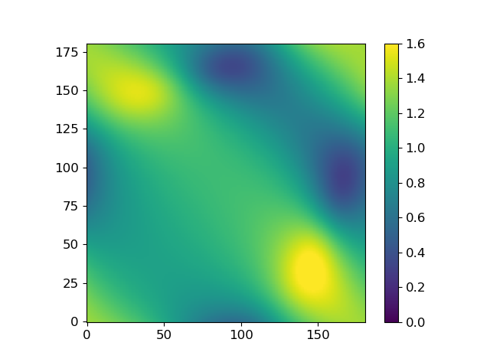
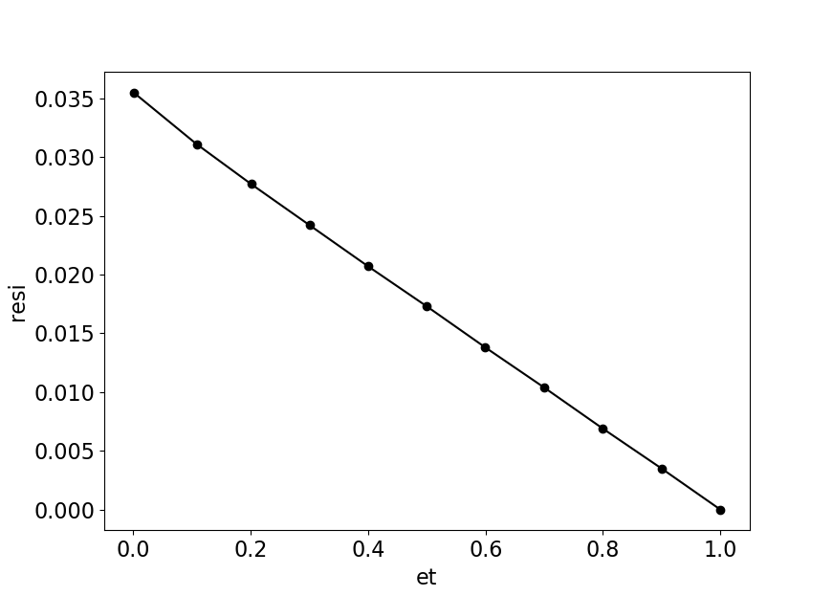
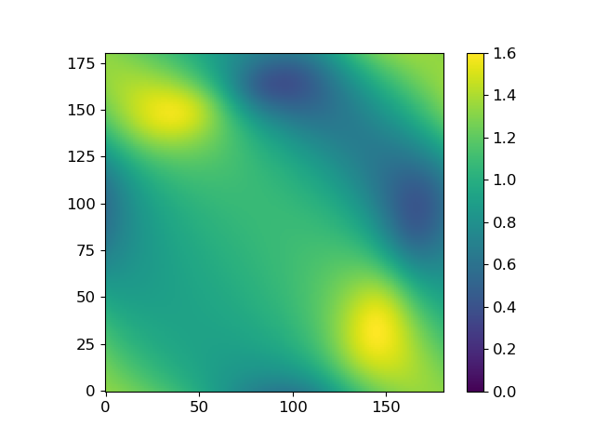
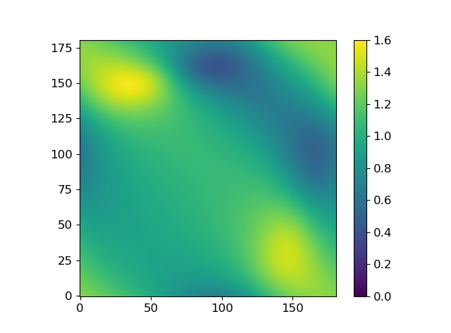
Raw portrait / model
[0, 60, 70, 90]
[1.0, 0.0, 0.0, 0.0]
[0.0, 1.0, 0.0, 0.0]
[0.0, 0.0, 1.0, 0.0]
[0.0, 0.0, 0.0, 1.0]
[0.9, 0.1, 0.0, 0.0]
[0.0, 1.0, 0.0, 0.0]
[0.0, 0.1, 0.9, 0.0]
[0.0, 0.1, 0.0, 0.9]
For the inhomogeneously distributed dipoles ([0, 60, 70, 90]), the model works better (the residue is decreased) when the energy transfer to one specific emitter. Because of the funnel, the system loses the excitaiton information (excitation anisotropy).
The higher the energy transfer efficiency, the less information of excitation can be left. The model works ideally when et = 1.
[0.8, 0.2, 0.0, 0.0]
[0.0, 1.0, 0.0, 0.0]
[0.0, 0.2, 0.8, 0.0]
[0.0, 0.2, 0.0, 0.8]

Slide 22
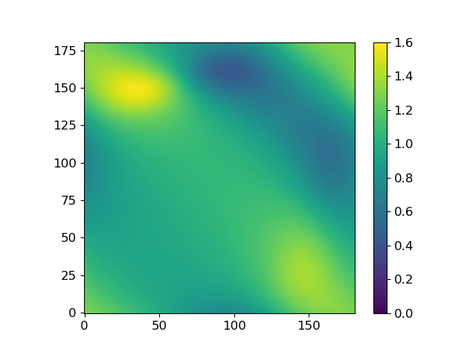

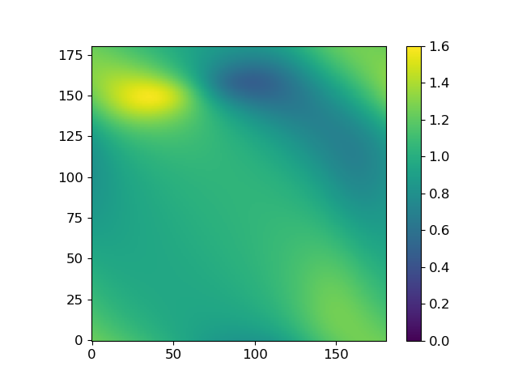
[0.7, 0.3, 0.0, 0.0]
[0.0, 1.0, 0.0, 0.0]
[0.0, 0.3, 0.7, 0.0]
[0.0, 0.3, 0.0, 0.7]
[0.6, 0.4, 0.0, 0.0]
[0.0, 1.0, 0.0, 0.0]
[0.0, 0.4, 0.6, 0.0]
[0.0, 0.4, 0.0, 0.6]
[0.5, 0.5, 0.0, 0.0]
[0.0, 1.0, 0.0, 0.0]
[0.0, 0.5, 0.5, 0.0]
[0.0, 0.5, 0.0, 0.5]

Slide 23
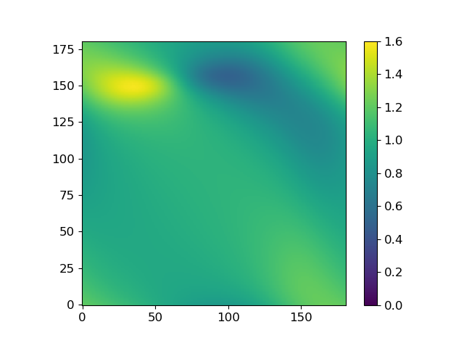
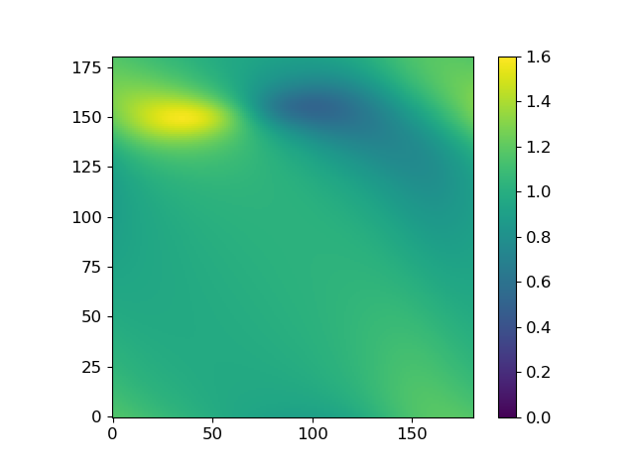
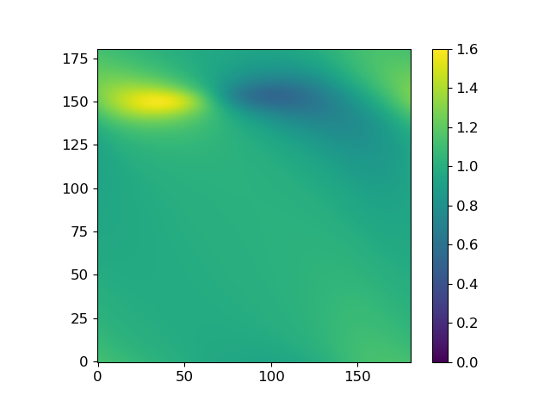
[0.4, 0.6, 0.0, 0.0]
[0.0, 1.0, 0.0, 0.0]
[0.0, 0.6, 0.4, 0.0]
[0.0, 0.6, 0.0, 0.4]
[0.3, 0.7, 0.0, 0.0]
[0.0, 1.0, 0.0, 0.0]
[0.0, 0.7, 0.3, 0.0]
[0.0, 0.7, 0.0, 0.3]
[0.2, 0.8, 0.0, 0.0]
[0.0, 1.0, 0.0, 0.0]
[0.0, 0.8, 0.2, 0.0]
[0.0, 0.8, 0.0, 0.2]

Slide 24
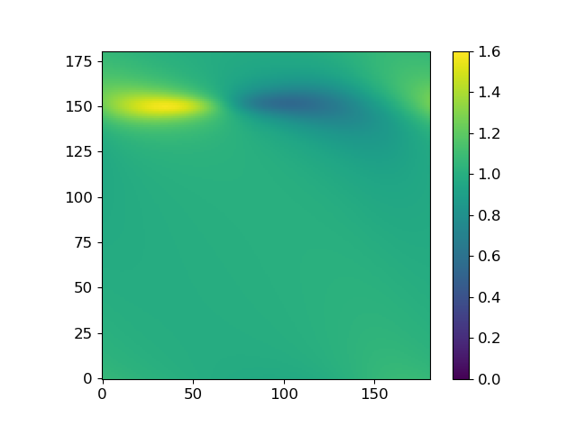
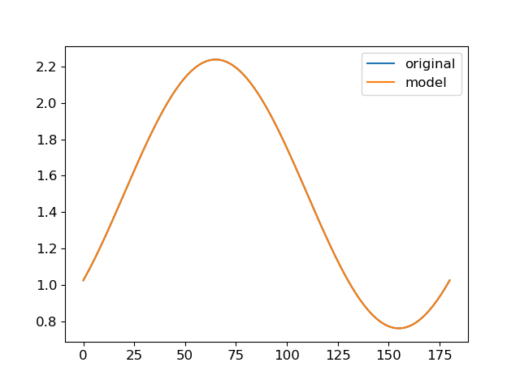
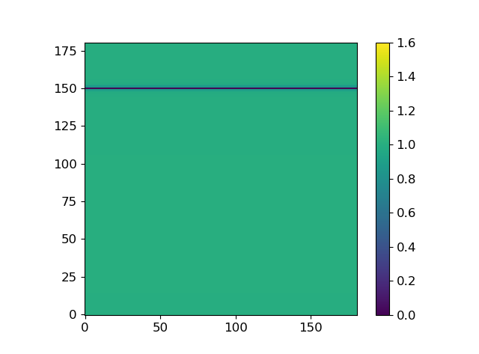
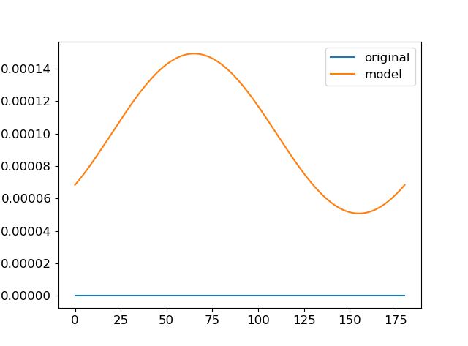
[0.1, 0.9, 0.0, 0.0]
[0.0, 1.0, 0.0, 0.0]
[0.0, 0.9, 0.1, 0.0]
[0.0, 0.9, 0.0, 0.1]
[0.0, 1.0, 0.0, 0.0]
[0.0, 1.0, 0.0, 0.0]
[0.0, 1.0, 0.0, 0.0]
[0.0, 1.0, 0.0, 0.0]
Numerical error

Slide 25
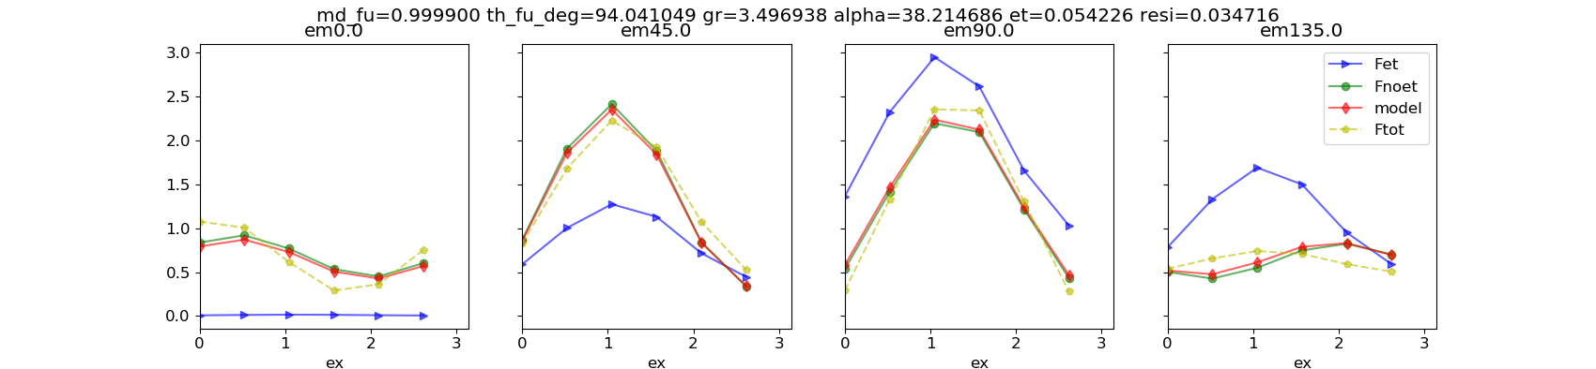
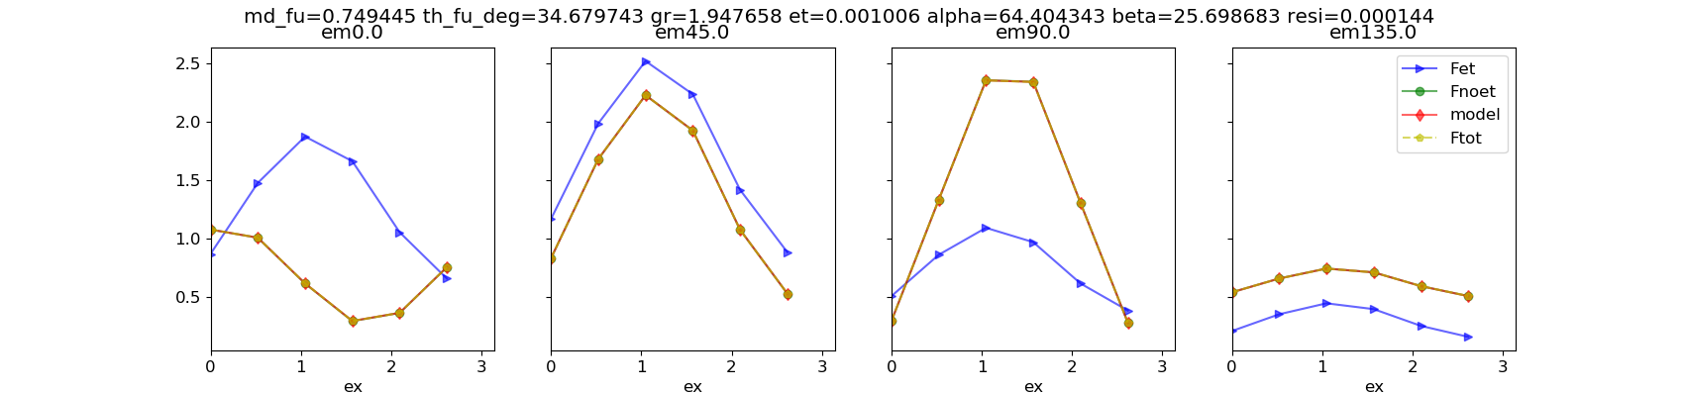
Break the symmetry of three-dipole model
[0, 60, 70, 90], no et
Symmetric three-dipole model. resi = 0.0347. the fitting is not ideal.
Unsymmetric three dipole model. resi = 0.0001.
Alpha = 64.4 degree, Beta = 25.7 degree

Slide 26
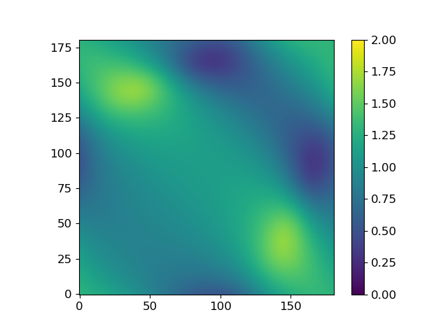
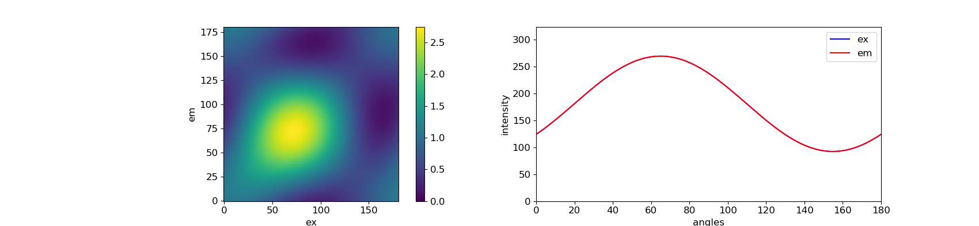
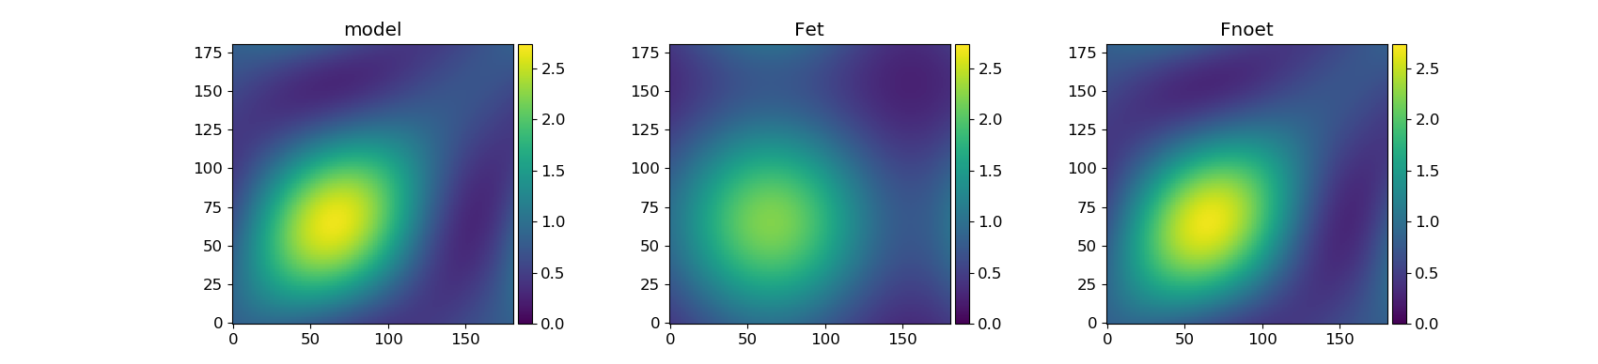
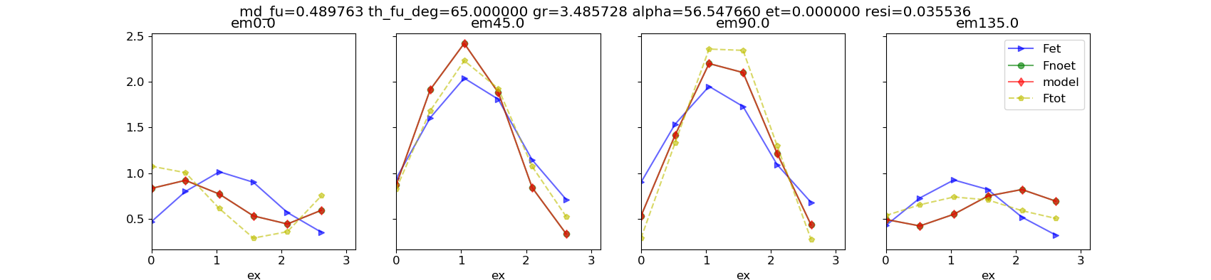
[0, 60, 70, 90], no et
Symmetric three dipole model
Original / model

Slide 27
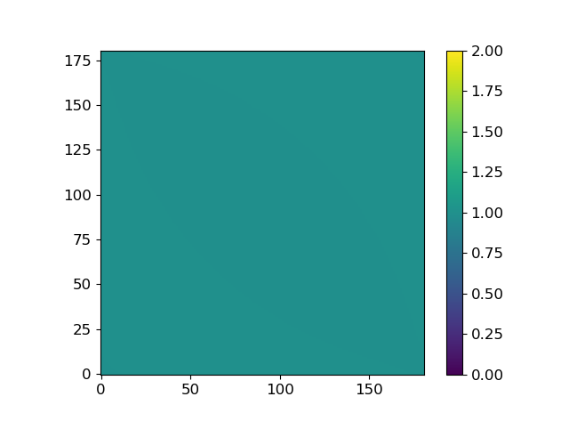

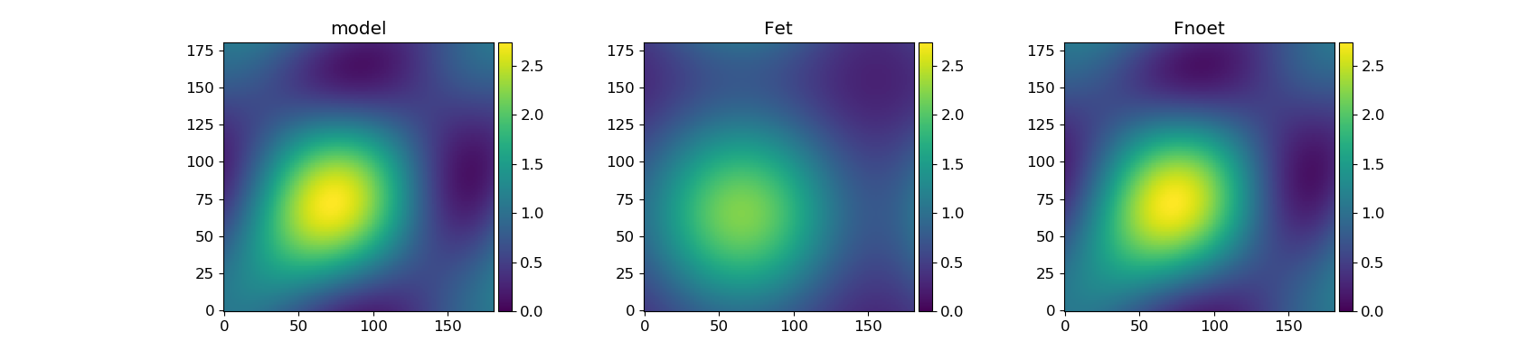
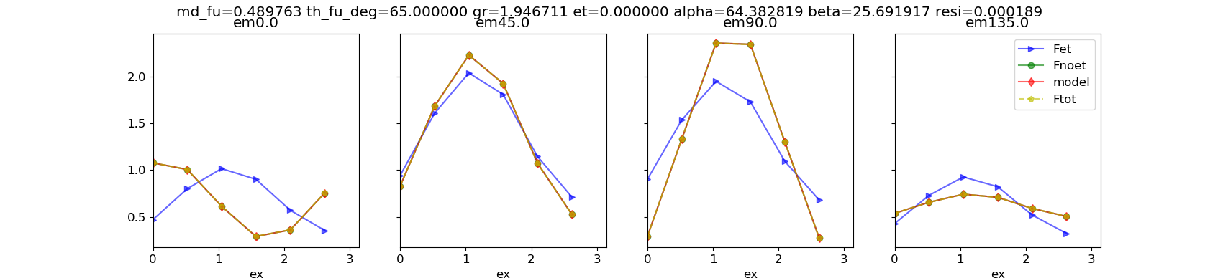
[0, 60, 70, 90], no et
Unsymmetric three dipole model
Original / model
et is fixed to 0

Slide 28
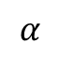
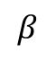
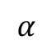
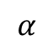
Original
Model
Original/Model
$$α$$
$$α$$
α = 57°
$$α$$
$$β$$
α = 64°
β = 26°

Slide 29
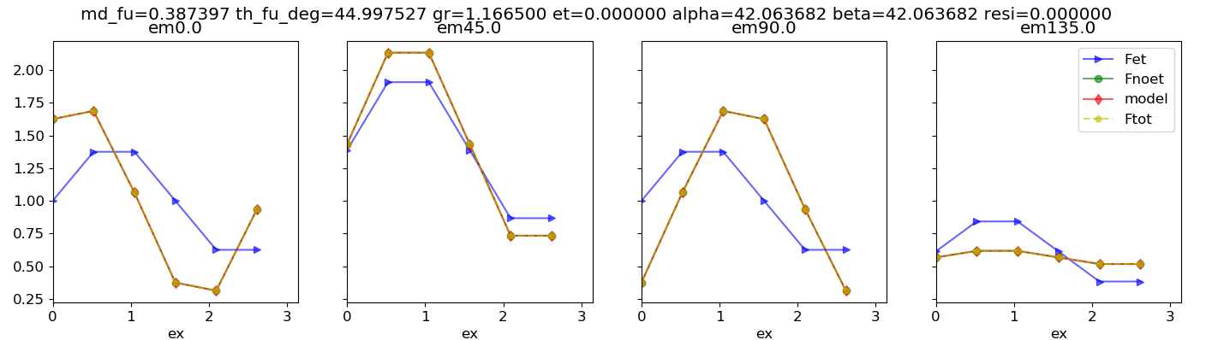
[0, 30, 60, 90], no et
If the system is symmetric, then alpha = beta
In the case [0 30 60 90], alpha = beta = 42.06 degree
et is not fixed to 0

Slide 30
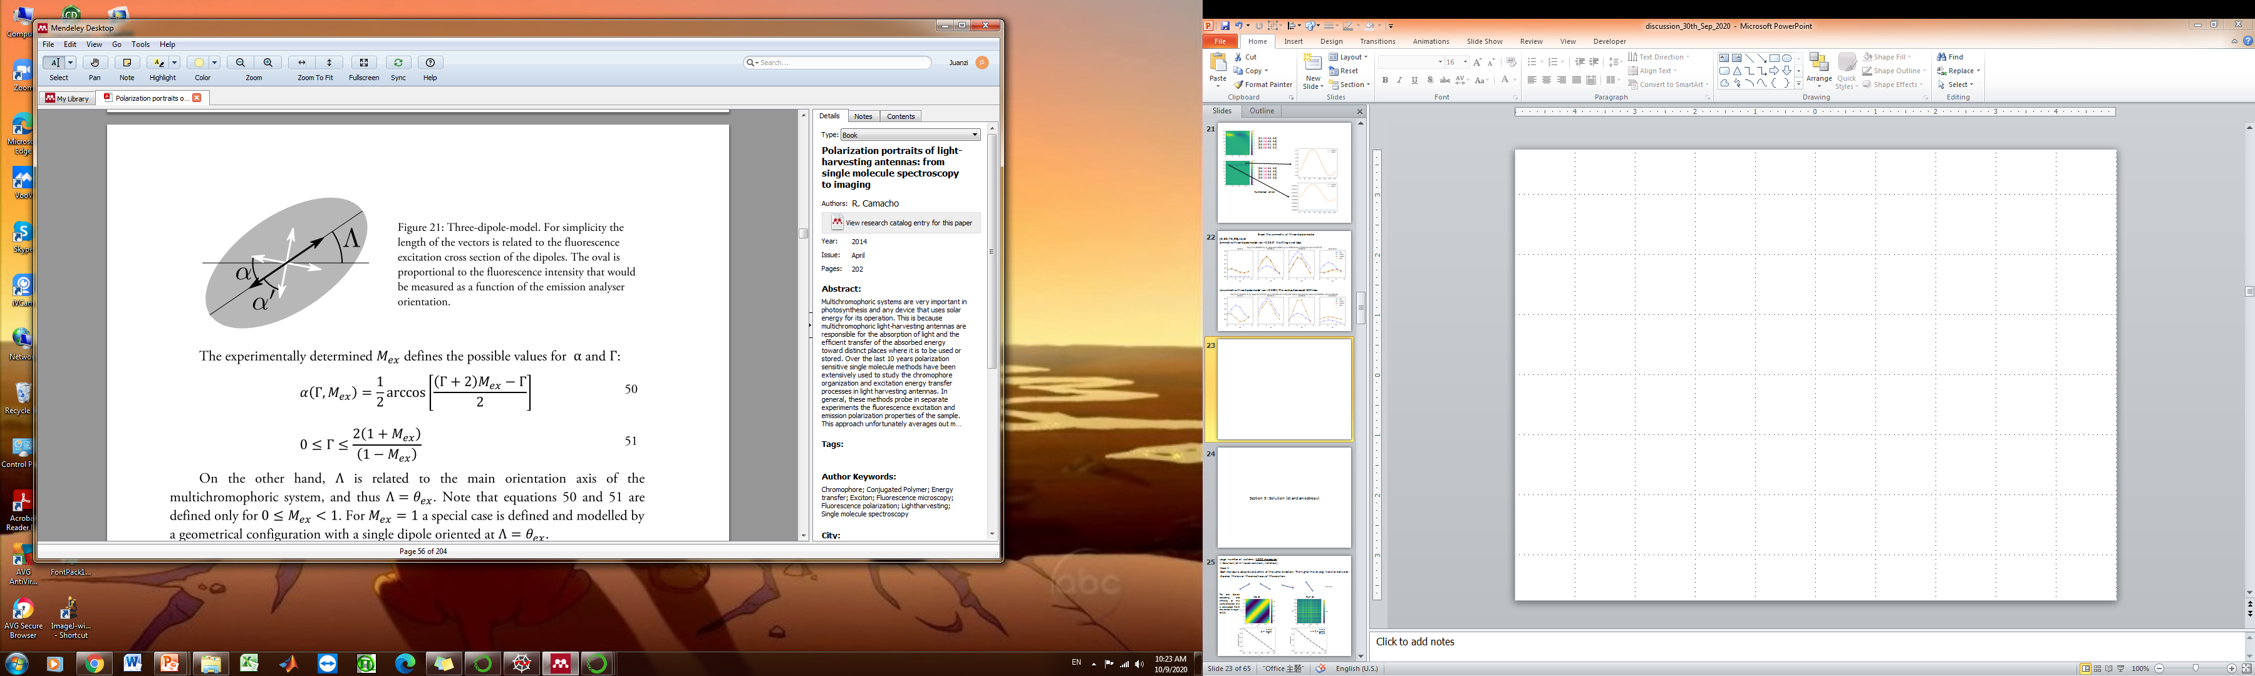



$$α$$
$$β$$

Slide 31
Section 3: Solution (et and anisotropy)

Slide 32






Large number of systems (1000 molecules)
-- Solution (et in frozen solution / rotation)
Case 1:
Each molecule absorbs and emits at the same direction. The higher the energy transfer between dipoles, the lower the anisotropy of the solution.
……
For one dipole absorbing and emitting at the same direction, the 𝜀 calculated from the model is equal to 0.0.
No et
Full et
$$p= \frac{1−ε}{2}$$
$$r=2×\frac{1−ε}{5+ε}$$

Slide 33




Case 2:
Each molecule absorbs and emits at different directions.
nReplicates = 50
N is the number of systems
bl = [1, 0]
$$et matrix=\left[\begin{matrix}0.0 & 1.0 \\ 0.0 & 1.0\end{matrix}\right]$$
100%
……
$$β$$

Slide 34









0°
40°
There are 1000 molecules in total.
Anisotropy r0 for different angles (β) calculated from the left 2D portraits.
90°
analytical solution for 2D. See detail in SI section2.
140°
$$r_{0}=\frac{24}{35}\cos^{2}\left(β\right)−\frac{2}{7}$$
$$r_{0}=2×\frac{1−ε}{5+ε}$$
170°

Slide 35



Case 3:
Each molecule consist of three symmetric dipoles. Two side dipoles are excited. Then energy transfer to the center dipole and emits.
nReplicates = 50
N is the number of systems
100%
……
100%
$$β$$
The et decreased slower when the absorber is more isotropic.
The more polarized the absorber, the less overlap of excitation.

Slide 36









1000 molecules
100%
100%
$$β$$
100%
100%
$$β$$
When the Mex is changed, the following analytical equation does not fit. The equation only works when the absorber is a dipole.
100%
100%
$$β$$
$$r_{0}=\frac{24}{35}\cos^{2}\left(β\right)−\frac{2}{7}$$
$$r_{0}=2×\frac{1−ε}{5+ε}$$

Slide 37
Section 4: ‘special situation’
Do not know how to explain yet, discuss with Rafael again

Slide 38





For multiple systems, it is always important to consider if each system have the same absorbers and emitters. Below are examples that two systems possess different absorbers and emitters.
[0°, 30°]
[0°, 60°]
et portrait plays a role to break the symmetry. If the 2D portrait are still axis symmetric along both diagonal and x/y axis after energy transfer, then the model can not work.
Maximum residue is at 90 degree, because the portrait has the highest symmetry in comparison with others.
[0°, 90°]
[0°, 120°]

Slide 39

For multiple systems, it is always important to consider if each system have the same absorbers and emitters. Below are examples that two systems possess different absorbers and emitters.
[0°, 90°]
$$et matrix=\left[\begin{matrix}0.0 & 1.0 \\ 1.0 & 0.0\end{matrix}\right]$$

Slide 40





[0°, 60°]
$$et matrix=\left[\begin{matrix}1.0 & 0.0 \\ 0.0 & 1.0\end{matrix}\right]$$

Slide 41





[0°, 60°]
$$et matrix=\left[\begin{matrix}0.8 & 0.2 \\ 0.2 & 0.8\end{matrix}\right]$$
et = 0.2 * 2
The et does not make sense. It can not be higher than 0.2.
Few degree of freedom
In some cases, there is not only one solution.

Slide 42





[0°, 60°]
$$et matrix=\left[\begin{matrix}0.7 & 0.3 \\ 0.3 & 0.7\end{matrix}\right]$$
et = 0.3 * 2

Slide 43





[0°, 60°]
$$et matrix=\left[\begin{matrix}0.5 & 0.5 \\ 0.5 & 0.5\end{matrix}\right]$$
et = 0.5 * 2

Slide 44




[0°, 60°]
$$et matrix=\left[\begin{matrix}0.3 & 0.7 \\ 0.7 & 0.3\end{matrix}\right]$$

Slide 45




[0°, 60°]
$$et matrix=\left[\begin{matrix}0.2 & 0.8 \\ 0.8 & 0.2\end{matrix}\right]$$

Slide 46




[0°, 60°]
$$et matrix=\left[\begin{matrix}0.0 & 1.0 \\ 1.0 & 0.0\end{matrix}\right]$$

Slide 47
Section 5: (Further plan)
Improvement of the model
Extract more info from 2D portrait

Slide 48



Improve the model - Mex from Model, Fnoet and Fet portrait
dipole orientation
[0, 30, 60, 90]
et matrix
[0.4, 0.6, 0.0, 0.0]
[0.0, 1.0, 0.0, 0.0]
[0.0, 0.6, 0.4, 0.0]
[0.0, 0.6, 0.0, 0.4]
fitting results
M_funnel = 0.99
Phase_funnel = 30°
gr = 1.17
et = 0.60
resi = 0.00
1
𝜺
1 - 𝜺
1. Model, Fet and Fnoet have the same Mex giving the info about orientation of dipoles (photoselection). Mex and phase_ex are used for three dipole model to calculate gr.
Do they (model, Fet, Fnoet) have to have the same Mex? Can Fet portrait have a different Mex? Can this improve the usability of SFA3 model?
Or I = (1-𝜀)*A + 𝜀*(B1 + B2 + B3...)
Then if Fet_Mex = Fnoet_Mex, it means multi-systems have the same absorption, or we can say there are only one system. If Fet_Mex ≠ Fnoet_Mex, it means there are many systems possessing different Mex.
2. How to undestand the curve on diagonal? They are not cos. Can this be an useful information?

Slide 49


FFT of non-cos curve
FFT of 2D portrait

Slide 50

Improve the model- [0, 60, 70, 90], no et, the fitting is not ideal.
raw portrait
The model does not work ideally when the dipoles are inhomogeneously distributed [0, 60, 70, 90].
Can we add a parameter to break the symmetry of the three dipole model? Done!
Raw portrait / model

Slide 51
SI

Slide 52
Section 1

Slide 53





[0°, 120°]
$$et matrix=\left[\begin{matrix}0.8 & 0.2 \\ 0.0 & 1.0\end{matrix}\right]$$
Phase_ex
One can judge if there is a single polarized emitter in the system from the phase and M of the funnel.
If the energy flow to only one dipole. No matter how much of the energy, SFA fitting always shows that M_funnel = 1, and phase of the funnel (the same as one of the emitter) is different from the average excitation phase.
The value of et shows how much energy transfer to this one emitter.

Slide 54




[0°, 30°, 60°, 90°]
[0.4, 0.6, 0.0, 0.0]
[0.0, 1.0, 0.0, 0.0]
[0.0, 0.6, 0.4, 0.0]
[0.0, 0.6, 0.0, 0.4]
M = 1
Phase of the funnel is different from the averaged excitation phase

Slide 55




0°, 30°, 60°, 90°
[1.0, 0.0, 0.0, 0.0]
[0.0, 1.0, 0.0, 0.0]
[0.2, 0.5, 0.3, 0.0]
[0.2, 0.5, 0.0, 0.3]
M = 1
Phase of the funnel is different from the averaged excitation phase

Slide 56
0°, 30°, 60°, 90°
[1.0, 0.0, 0.0, 0.0]
[0.0, 1.0, 0.0, 0.0]
[0.2, 0.5, 0.3, 0.0]
[0.2, 0.5, 0.0, 0.3]
M = 1
Phase of the funnel is different from the averaged excitation phase

Slide 57





[0°, 120°]
$$et matrix=\left[\begin{matrix}0.8 & 0.2 \\ 0.2 & 0.8\end{matrix}\right]$$
M is relatively low
phase is very close to the average excitation phase.
It means that there is energy transfer process in the system (et shows how much it is), but the energy does not go to one specific emitter.
100%
120°
100%
120°

Slide 58




[0°, 30°, 60°, 90°]
[0.8, 0.2, 0.0, 0.0],
[0.4, 0.6, 0.0, 0.0],
[0.0, 0.0, 0.5, 0.5],
[0.0, 0.0, 0.2, 0.8]
M is low
Phase of the funnel is close to the averaged excitation phase

Slide 59
Section 2

Slide 60



Slide 61
Section 3

Slide 62



Slide 63
The numbers of the absorbers are the same for all systems. The absorbers are oriented in P1 (0 – 180 degree), P2 (0 – 60 degree), P3 (20 – 40 degree).
The numbers of the absorbers are the same for all systems. The absorbers are oriented in P1 (0 – 180 degree), P2 (0 – 60 degree), P3 (20 – 40 degree).
1.0
1.0
1.0
1.0
0.2
0.6
36°
36°
36°
36°
36°
36°
P1
P2
P3
P1
P2
P3
et_1 = 1.0
et_2 = 1.0
et_3 = 1.0
et_1 = 1.0
et_2 = 0.2
et_3 = 0.6
Pms = P1 + P2 + P3
Pms = P1 + P2 + P3
SFA3 fitting results
 | P1 | P2 | P3 | Pms
M_funnel | 0.99 | 0.99 | 0.99 | 0.99
phase_funnel (degree) | 36.00 | 36.00 | 36.00 | 36.00
𝜀 | 1.00 | 1.00 | 1.00 | 0.99
residue | 0.00 | 0.00 | 0.00 | 0.001
SFA3 fitting results
 | P1 | P2 | P3 | Pms
M_funnel | 0.99 | 0.99 | 0.99 | 0.99
phase_funnel (degree) | 36.00 | 35.99 | 35.99 | 35.1
𝜀 | 1.00 | 0.20 | 0.60 | 0.84
residue | 0.00 | 0.00 | 0.00 | 0.002
The residue is slightly higher, but SFA model still can works.
𝜀1 = 𝜀2 = 𝜀3 = 1 then 𝜀_ms = 1 as well.
Chromophores have the same et to the same emitter.
The property of funnel is independent on the anisotropy of sample (dipole orientation).
More test:
𝜀1 = 𝜀2 = 𝜀3 = 0.2 then 𝜀_ms = 0.2 as well.
The residue is slightly higher, but SFA model still works well.
𝜀_ms [0.84] ＞ (𝜀1 + 𝜀2 + 𝜀3)/3 [0.6], Why???
The property of funnel is independent on the anisotropy of sample (dipole orientation).

Slide 64




From 0 to 180 degree, 1000 dipoles
Emitter 1 – 0 degree [0]
Emitter 2 – 36 degree [200]
1000

Slide 65




20 dipoles
Emitter 1 – 0 degree [0]
Emitter 2 – 36 degree [4]

Slide 66




5 dipoles
Emitter 1 – 0 degree[0]
Emitter 2 – 36 degree[1]

Slide 67

How to split one et matrix into multiple systems.

Slide 68

The model works better when there is energy exchange between two emitters.
The above effect is not obvious when the number of absorbers >> the number of emitters. As shown in the cartoon, the fitting results of these two systems is the same. The funnel is linear superposition of emitters.
$$I= \overline{I}[M×\cos\left(2×\left[φ−θ\right]\right)+1]$$
$I_{funnel}=I_{emitter1}+I_{emitter2}+I_{emitter3}$ …
If we consider the small system as conjugated polymer chain or aggregates of nanocrystals, case 2 is more close to the reality. By trying different number of dipoles and different energy transfer matrix, I get the following conclusion. High M_funnel is a signal that the energy flow to one funnel, et shows how much energy flow to there. Low M_funnel is a sign that there are many independent systems, and energy transfer happens in each system. (See more details in SI section 1).
0.4
emitter1
Model works ideally.
M = 0.81
Phase = 22 degree
gr= 1.0
et = 1.0
residue = 0.000000
0.4
emitter1
Model works ideally.
M = 0.81
Phase = 22 degree
gr= 0.99
et = 0.99
residue = 0.000054
0.4
0.6
0.6
emitter2
0.6
emitter2
M_funnel | phase_funnel | et
High | Different from the averaged excitation phase | The amount of energy are transferred | Energy flow to One or several specific emitters (funnel effect)
Low | Close to the averaged excitation phase | The amount of energy are transferred | There is some independent systems. And the energy transfer within each system.

Slide 69
[0, 60, 70, 90], no et
Symmetric three dipole model

Slide 70
[0, 60, 70, 90], no et
Unsymmetric three dipole model

Slide 71



[0, 20, 80], no et, the fitting is not ideal.
Symmetric three dipole model.
Resi = 0.046527

Slide 72



[0, 20, 80], no et, the fitting is not ideal.
Unsymmetric three dipole model. The residue is four times lower than the symmetric model.
Resi = 0.01111

